Slide 1



Multimedia & Graphics
Class VI
lab 20

Slide 2
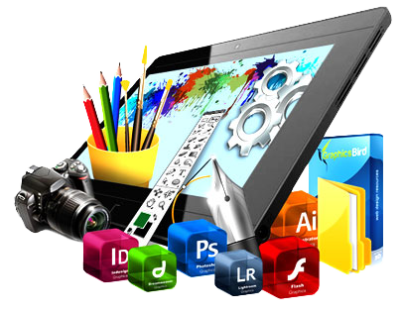
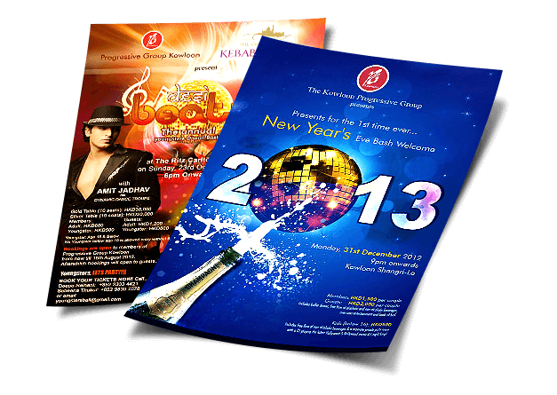
Flyer Design
A flyer is a form of paper advertisement intended for wide distribution and typically posted or distributed in a public place

Slide 3
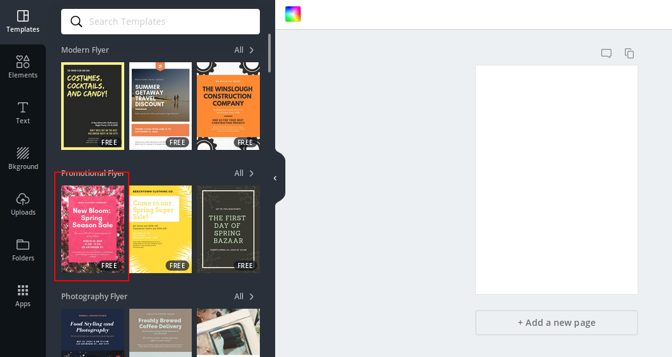
Canva Templates
go to “canva” and choose
a template to design
your flyer

Slide 4

Selected Template
Edit your fashion house
name and add your
offer name

Slide 5
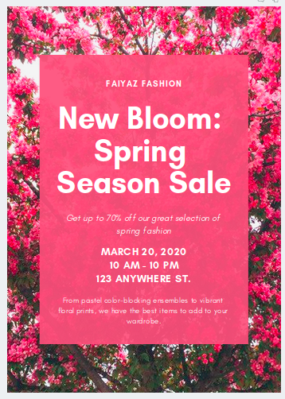
Selected Template
we have selected
our template. Edit text
to make your own
advertisement

Slide 6

Selected Template
add discount percentage and
mention your house
address

Slide 7

Selected Template
remove unnecessary
text

Slide 8



